Slide 1
Chapter six
CENTRAL PROCESSING UNIT

Slide 2
Outline
Introduction
General Register Organizations
Stack Organization
Instruction Formats
Addressing Modes
Data Transfer and Manipulation
Program Control
CISC and RISC

Slide 3
Introduction
CPU is the brain or engine of the PC and it performs the bulk of system's calculating and data processing.
CPU is an integrated circuit that holds most of the works of a computer.
The CPU is usually the most expensive component in the system, costing up to four or more times greater than the motherboard it plugs into

Slide 4
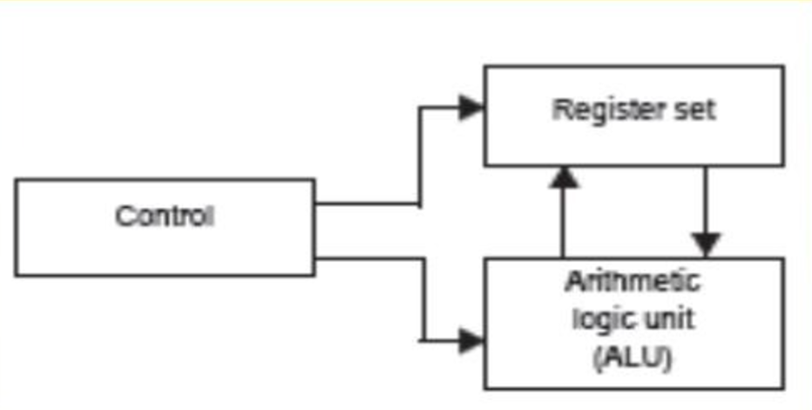
Major Components of CPU
The CPU is made up of three major parts, as shown in figure below

Slide 5
Cont...
Arithmetic Logic Unit (ALU):-performs the required micro-operations (arithmetic & logical operations) for executing the instructions.
Register set: - stores intermediate data used during the execution of the instructions.
Control Unit:-supervises the transfer of information among the registers and instructs the ALU as to which operation to perform

Slide 6
General Register Organizations
Since having to refer to memory location for different applications is time consuming, it is more convenient and more efficient to store intermediate values (such as pointers, counters, return addresses, temporary results, etc.) in processor registers.
The registers communicate with each other not only for direct data transfers.
Hence it is necessary to provide a common unit that can perform all the arithmetic, logic, and shift micro-operations in the processor
The design of a CPU is a task that involves choosing the hardware for implementing the machine instructions.
Let us describe how registers communicate with the ALU through buses and explain the operation of the memory stack.

Slide 7
Cont...
The control unit that operates the CPU bus system directs the information flow through the registers and ALU by selecting the various components in the system

Slide 8
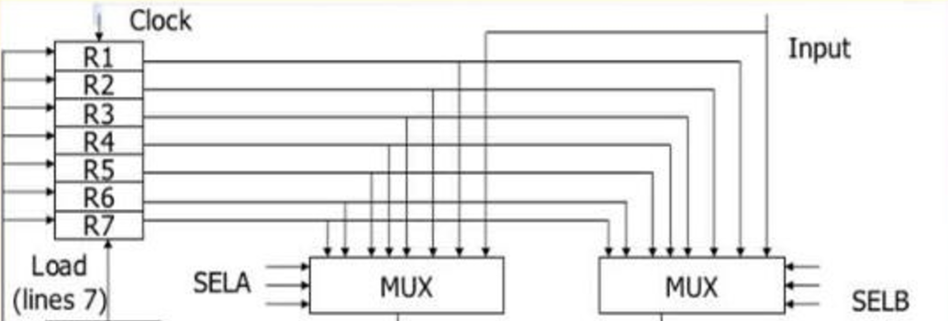
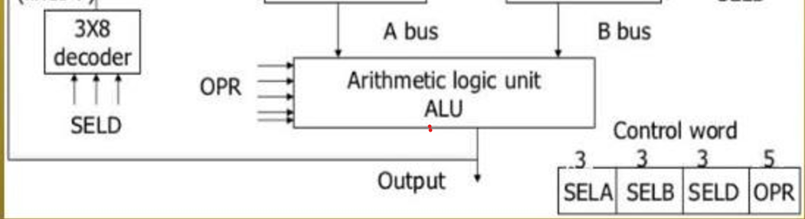
Register set with common ALU

Slide 9
Cont...
For example, to perform the operation:
R1 R2 + R3
The control must provide binary selection variables to the following selector inputs:
MUX A Selector (SELA):to place the content of R2 into bus A.
MUX B Selector (SELB):to place the content of R3 into bus B.
ALU operation selector (OPR):to provide the arithmetic addition A + B.
Decoder destination selector (SELD):to transfer the content of the output bus on

Slide 10
Stack Organization
A useful feature that is included in the CPU of most computer is a stack or Last-In-First-Out (LIFO) list.
A stack is a storage device that stores information in such a manner that the item stored last is the first item retrieved.
The stack in digital computers is essentially a memory unit with an address register that can count only (after an initial value is loaded into it)
The register that holds the address for the stack is called a stack pointer (SP) because its value always points at the top item in the stack.
The physical registers of a stack are always available for reading or writing.
It is the content of the word that is inserted or deleted

Slide 11
Cont...
The two operations of a stack are the insertion and deletion of items.
The operation of insertion is called push(or push-down) because it can be thought of as the result of pushing a new item on top of a stack.
The operation of deletion is called pop(or pop-up) because it can be through of as the result of removing one item so that the stack pops up
However, nothing is pushed or popped in a computer stack.
These operations are simulated by incrementing or decrementing the stack pointer register.

Slide 12
Cont...
Register Stack
A Stack can be placed in a portion of a large memory or it can be organized as a collection of a finite number of memory words or registers
Figure below shows the organization of a 64-word register stack

Slide 13
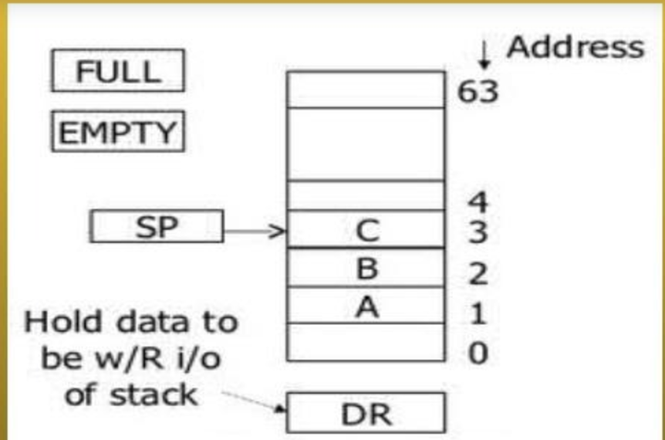
Cont...
Figure: Block Diagram of a 64 word stack

Slide 14
Cont...
The stack pointer register SP contains a binary number whose values is equal to address of the word that is currently on top of the stack.
Three items are placed in the stack: A, B, and C.
In that order, item C is on top of the stack so that the contents of SP now 3.
In a 64 - word stack, the stack pointer contains 6 bits because 26 =64. Since SP has only six bits, it cannot exceed a number greater than 63 (111111 in binary).

Slide 15
Cont...
When 63 is incremented by 1, the result is 0 since 111111 + 1 = 1000000 in binary, but SP can accommodate only the six least significant bits
Similarly, when 000000 is decremented by1, the result is 111111
The one-bit register 1 when the stack is empty of items. DR is the data register that hold the binary data to be written into or read out of the stack
Initially, SP is cleared to 0, EMTY is set to 1, and FULL is cleared to 0, so that SP points to the word at address 0 and the stack is marked empty and not full.
If the stack is not full (if FULL = 0), a new item is inserted with a push operation. The push operation is implemented with the following sequence of micro- operations :SP SP + 1 Increment stack pointer

Slide 16
Cont...
M[SP] DR Write item on top of the stack
If(SP=0) then (FULL 1)Check if Stack is full
EMTY 0Mark the stack not empty
A new item is deleted from the stack if the stack is not empty (if EMTY = 0).
The pop operation is implemented with the following sequence of micro-operation:
DR M[SP] Read item from the top of stack.
SP SP – 1 Decrement stack pointer
If (SP=0) then (EMTY 1)Check if stack is empty
FULL 0 Mark the stack not f

Slide 17
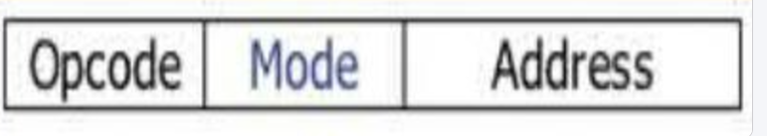
Instruction Formats
A computer will usually have a variety of instruction code formats. It is the function of the control unit within the CPU to interpret each instruction code and provide the necessary control functions needed to process the instruction.
The format of an instruction is usually depicted in a rectangular box symbolizing the bits of the instruction as they appear in memory words or in a control register.
A computer instruction has the following format

Slide 18
Cont...
The bits of the instruction are divided into groups called fields
The most common fields found in instruction formats are:
An operation code field that specifies the operations to be performed (add, subtract, complement, and shift.)
An address field that designates a memory address or a processor registers.
A mode field that specifies the way the operand or the effective address is determined.(Optional)
Computers may have instructions of several different lengths containing varying number of addresses which depends on the internal organization of its registers

Slide 19
Cont...
Most computer fall into one of three types of CPU organization:
Single accumulator organization.
2. General register organization.
3. Stack organization.
All operations are performed with an implied accumulator register. The instruction format in this type of computer uses one address field

Slide 20
Addressing Modes
The way the operands are chosen during program execution is dependent on the addressing mode of the instruction
The addressing mode specifies a rule for interpreting or modifying the address field of the instruction before the operand is actually referenced
Computers use addressing mode techniques for the purpose of accommodating one or both of the following provisions:
To give programming versatility to the user by providing such facilities as Pointers to memory, counters for loop control, indexing of data, and program relocation.
To reduce the number of bits in the addressing field of the instruction

Slide 21
Cont...
To understand the various addressing modes, it is important to understand the following basic instruction cycle phases of the computer: •
Fetch the instruction from memory.
Decode the instruction
Execute the instruction.
Program counter (PC) is a register that keeps track of the instructions in the program stored in memory PC holds the address of the instruction to be executed next and is incremented each time an instruction is fetched from memory
The decoding done in step 2 determines the operation to be performed, the addressing mode of the instruction, and the location of the operands.
The computer then executes the instruction and return to step 1 to fetch the next instruction in sequence.

Slide 22
Cont...
The common categories of addressing modes are the followings:
Implied Mode
In this mode the operands are specified implicitly in the definition of the instruction.
Examples:
All register reference instructions that use an accumulator.
Zero-address instructions in a stack- organized computer
Immediate Mode
In this mode the operand is specified in the instruction itself
In other words, an immediate- mode instruction has an operand field rather than an address field
Immediate- mode instructions are useful for initializing registers to a constant value

Slide 23

Cont...
Note: Both implied and immediate modes do not need address field at all
Register Mode
In this mode, the address field (operand) specifies a processor register
The particular register is selected from a register field in the instruction
A k-bit field can specify any one 2^{k} registers.

Slide 24
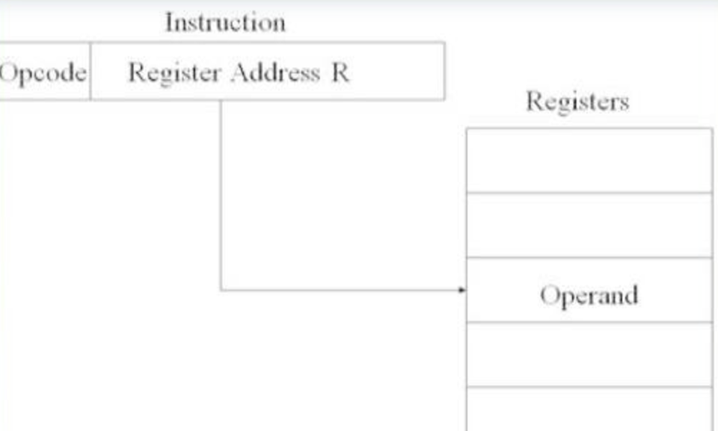
Cont...

Slide 25
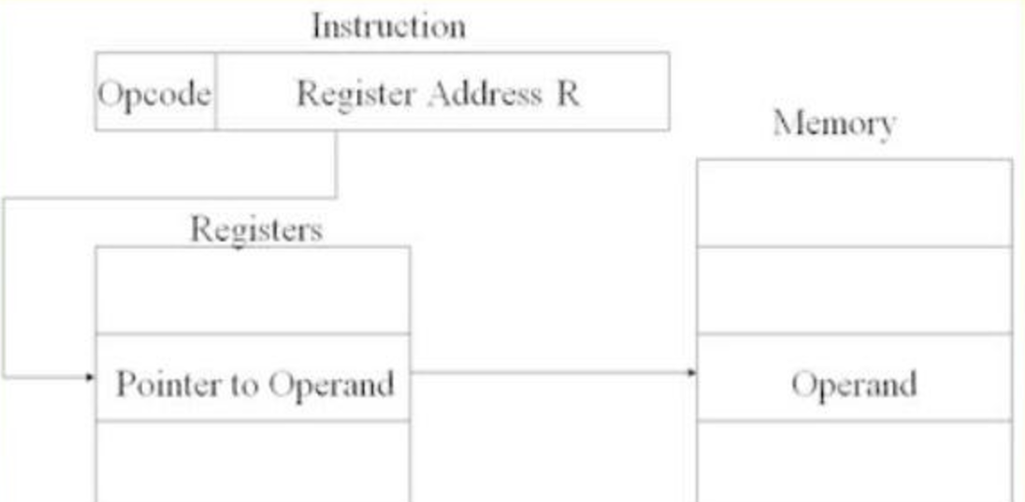
Cont...
Register Indirect Mode
In this mode the instruction specifies a register in the CPU whose contents give the address of the operand in memory
In other words, the selected register contains the address of the operand rather than the operand itself

Slide 26
Cont...
Auto increment or Auto decrement Mode
This is similar to the register indirect mode except that the register is automatically incremented or decremented after (or before)its value is used to access memory
Indirect Address Mode
In this mode the address field of the instruction gives the address where the effective address is stored in memory.
Control fetches the instruction from memory and uses its address part to access memory again to read the effective address.
The effective address in these modes is obtained from the following computation

Slide 27
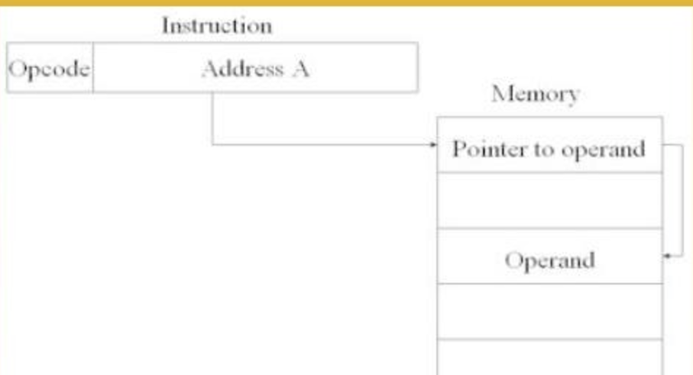
Cont...
Effective address = address part of instruction + content of CPU register

Slide 28
Cont...
Relative Address Mode
In this mode the content of the program counter is added to the address part of the instruction in order to obtain the effective address
The address part of the instruction is usually a signed number (in 2's complement representation) which can be either positive or negative
Indexed Addressing Mode
In this mode the content of an index register is added to the address part of the instruction to obtain the effective address
The index register is a special CPU register that contains an index value
The address field of the instruction defines the beginning address of a data array in memory

Slide 29
Data Transfer and Manipulation
Most computer instructions can be classified into the following categories:
Data transfer instructions
Data manipulation instructions
Program control instructions
1. Data Transfer Instruction • Data transfer instructions move data from one place to another without changing the data content
The most common transfer are between memory and processor register, between processor register and input or output, and between the processor register s themselves
The following table gives a list of eight data transfer instruction used in many computers

Slide 30
Cont...
Table 6.1 : Typical Data Transfer Instruction
Name | Mnemonic
Load | LD
Store | ST
Move | MOV
Exchange | XCH
Input | IN
Output | OUT
Push | PUSH
Pop | POP

Slide 31
Cont...
Data Manipulation Instructions : perform operations on data and provide the computational capabilities for the computer
The data manipulation instructions in a typical computer are usually divided into three basic types:
Arithmetic instructions
Logical and bit manipulation instructions
Shift instructions
Arithmetic Instructions :the four basic arithmetic operations are addition, subtraction, multiplication and division.
Most computers provide instructions for all four operations

Slide 32
Cont...
Table 6.2 : Typical Arithmetic Instruction
Name | Mnemonic
Increment | INC
Decrement | DEC
Add | ADD
Subtract | SUB
Multiply | MUL
Divide | DIV
Add with carry | ADDC
Subtract with borrow | SUBB
Negate( 2’s complement) | NEG

Slide 33
Cont...
Logical and Bit Manipulation Instructions : Logical instructions perform binary operation on strings of bits stored in registers
They are useful for manipulating individual bits or a group or bits that represent binary-coded information.
Some typical logical and bit manipulation instructions are listed in table below

Slide 34
Cont...
Table 6.3: Typical Logical and Bit Manipulation Instructions
Name | Mnemonic
Clear | CLR
Complement | COM
AND | AND
OR | OR
Exclusive-OR | XOR
Clear carry | CLRC
Set carry | SETC
Complement carry | COMC
Enable interrupt | EI
Disable interrupt | DI

Slide 35
Cont...
Shift instruction: Instructions to shift the content of an operand are quite useful and are often provided in several variations
Shifts are operations in which the bits or a word are moved to the left or to right
Shift instructions may specify either logical shifts, arithmetic shifts, or rotate- type operations

Slide 36
Cont...
Table:6.4 Typical Shift Instructions
Name | Mnemonic
Logical shift right | SHR
Logical shift left | SHL
Arithmetic shift right | SHRA
Arithmetic shift left | SHLA
Rotate right | ROR
Rotate left | ROL
Rotate right through carry | RORC
Rotate left through carry | ROLC

Slide 37
Program Control
In other words, program control instructions specify conditions for altering the content of the program counter, while data transfer and manipulation instructions specify conditions for data- processing operations
The change in value of the program counter as a result of the execution of a program control instruction causes a break in the sequence of instruction execution
This is an important feature in digital computers, as it provides control over the flow of program execution and a capability for branching to different program segments

Slide 38
Cont...
Table 6.5 : Typical Program Control Instructions
Name | Mnemonic
Branch | BR
Jump | JMP
Skip | SKP
Call | CALL
Return | RET
Compare( by subtraction) | CMP
Test (by AND ing) | TST

Slide 39
Cont...
Program Interrupt
Program interrupt refers to the transfer of program control from a currently running program to another service program as a result of an external or internal generated request
Control returns to the original program after the service program is executed
The interrupt procedure is similar to a subroutine call except for three variations
The interrupt is usually initiated by an internal or external signal rather that from the execution of an instruction (except for software interrupt )

Slide 40
Cont...
The address of the interrupt service program is determined by the hardware rather that from the address field of an instruction; and
An interrupt procedure usually stores all the information necessary to define the state of CPU rather than storing only the program counter.
Program status word
The collection of all status bit conditions in the CPU is sometimes called a program status word or PSW
The PSW is stored in a separate hardware register and contains the status information that characterizes the state of the CPU

Slide 41
Types of Interrupts
There are three major types of interrupts that cause a break in the normal execution of a program. •
External interrupts
Internal interrupts
Software interrupts
External interrupts come from input - output (I/O) devices, from a timing device, from a circuit monitoring the power supply, or from any other external source.
External interrupts depend on external conditions that are independent of the program being executed at the time

Slide 42
Cont...
Internal interrupts arise from illegal or erroneous use of an instruction or data
Internal interrupts are also called traps.
Examples of interrupts caused by internal error conditions are register overflow, attempt to divide by zero, an invalid operation code, stack overflow, and protection violation
Software interrupt is initiated by executing an instruction.
It is a special call instruction that behaves like an interrupt rather than a subroutine call
It can be used by the programmer to initiate an interrupt procedure at any desired point in the program
The most common use of software interrupt is associated with a supervisor call instruction

Slide 43
CISC and RISC
CISC and RISC are aspects of computer architecture
Complex Instruction Set Computer (CISC)
The major characteristics of CISC architecture are:
A large number of instructions - typically from 100 to 250 instructions
Some instructions that perform specialized tasks and are used infrequently.
A large variety of addressing modes-typically from 5 to 20 different modes.
Variable-length instruction formats
Instructions that manipulate operands in memory

Slide 44
Cont...
Reduced Instruction Set Computer (RISC)
The major characteristics of RISC architecture are:
Relatively few instructions
Relatively few addressing modes.
Memory access limited to load and store instructions
All operations done within the registers of the CPU
Fixed-length, easily decoded instruction execution
Single-cycle instruction execution
Hardwired rather than micro programmed control

Slide 45
Cont...
Other characteristics attributed to RISC architecture are:
A relatively large number of register in the processor unit
Use of overlapped register windows to speed-up procedure call and return
Efficient instruction pipeline
Compiler support for efficient translation of high-level language programs into machine language programs

Slide 46
?

